Slide 1


ONLIFE: Empower hybrid Competences for Onlife Adaptable Teaching in School Education in times of pandemic
ONLIFE- Final Event - Brussels
3 May 2023, European Parliament
Reference Number: 2020-1-PL01-KA226-SCH-095529
Title: Welcome to the project, background
Presenter: Tomasz Szemberg
This project has been funded with support from the European Commission. This PowerPoint reflects the views only of the author, and the Commission cannot be held responsible for any use which may be made of the information contained herein.

Slide 2
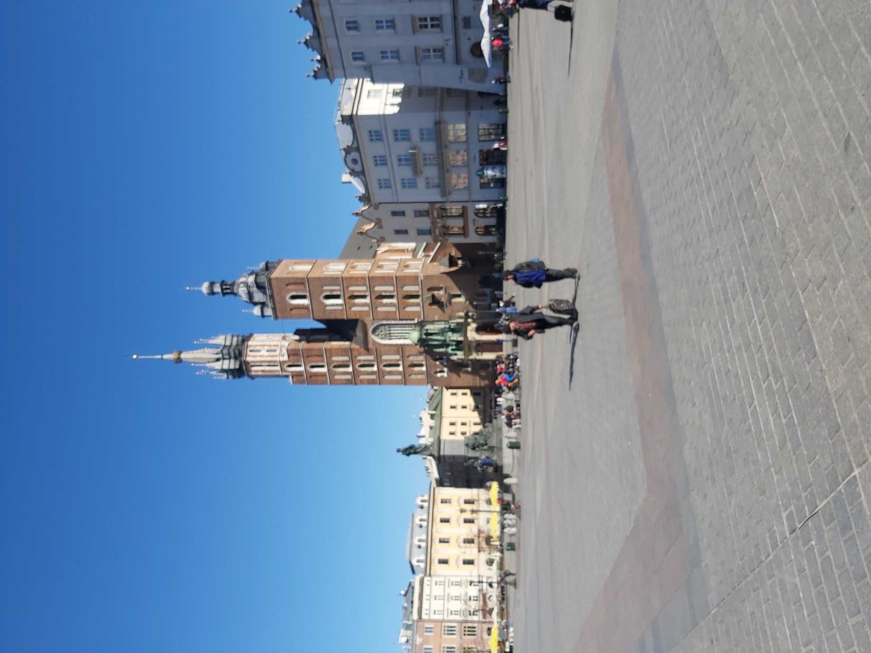
The day after (March 14, 2020)
The Main Market in Krakow

Slide 3
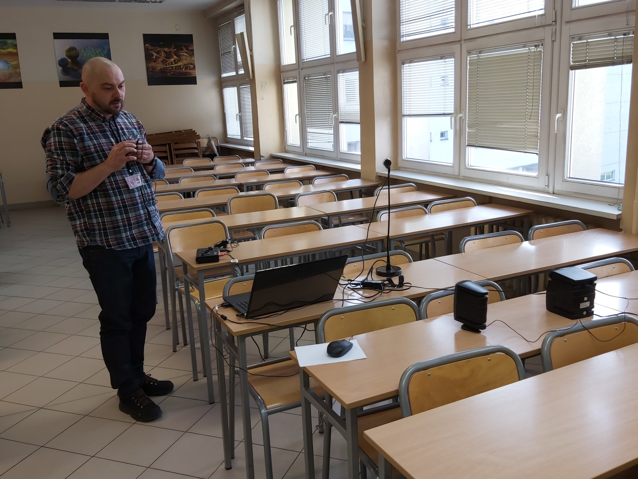
Three days after (March 16, 2020)
Building up an online teaching stage

Slide 4
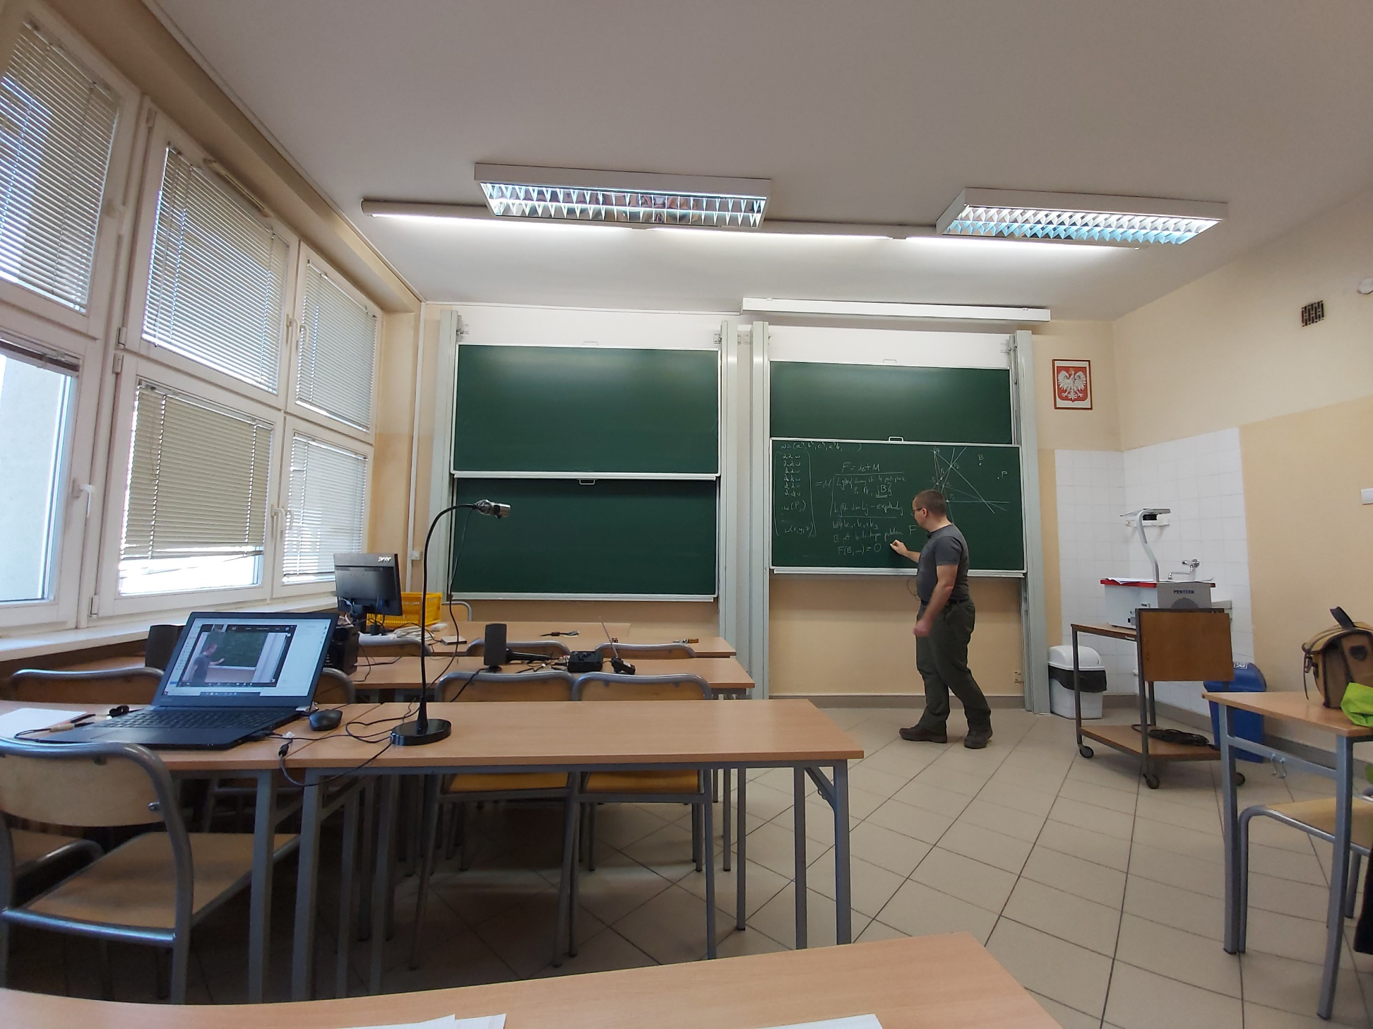
Four days after (March 17, 2020)
The first online research seminar on algebraic geometry

Slide 5
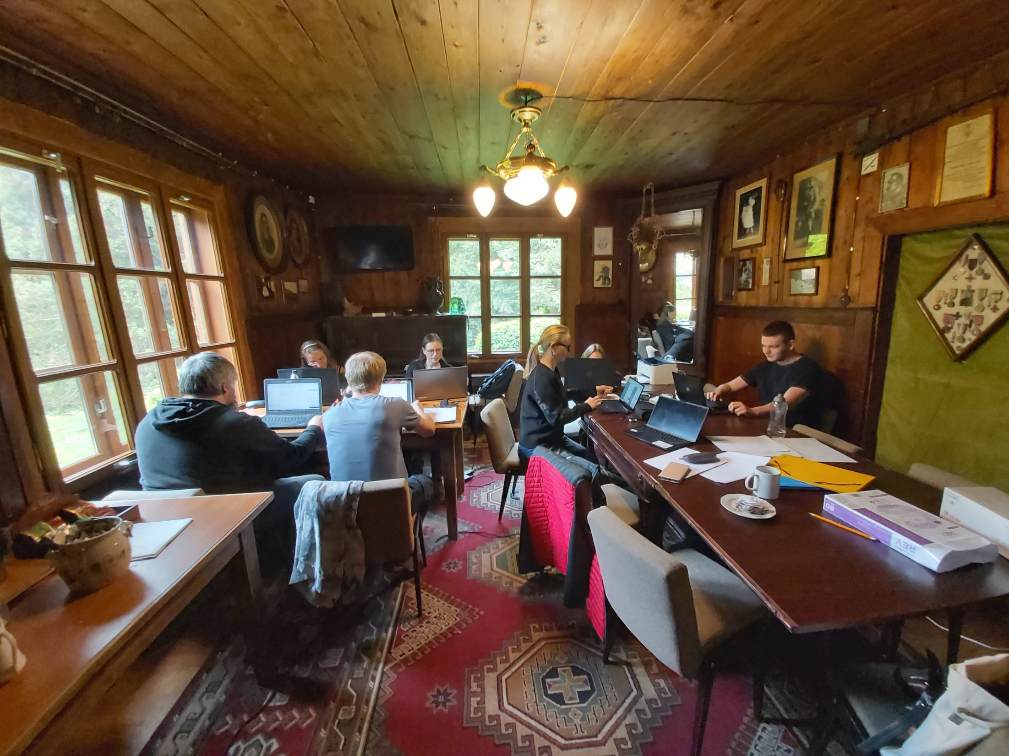
Two months after (May 13, 2020)
The first face to face conspiracy research workshop on algebraic geometry

Slide 6
444 days after (June 1, 2021)
The ONLIFE project begins

Slide 7
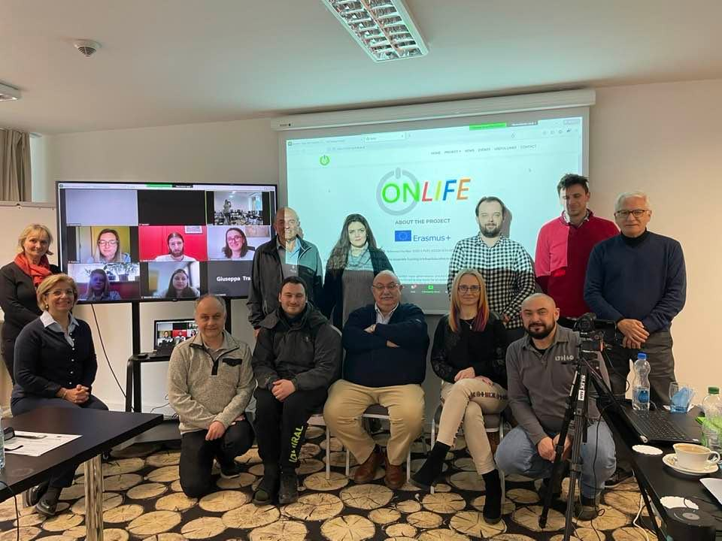
750 days after (March 1-2, 2022)
The first ONLIFE project meeting in a hybrid form

Slide 8
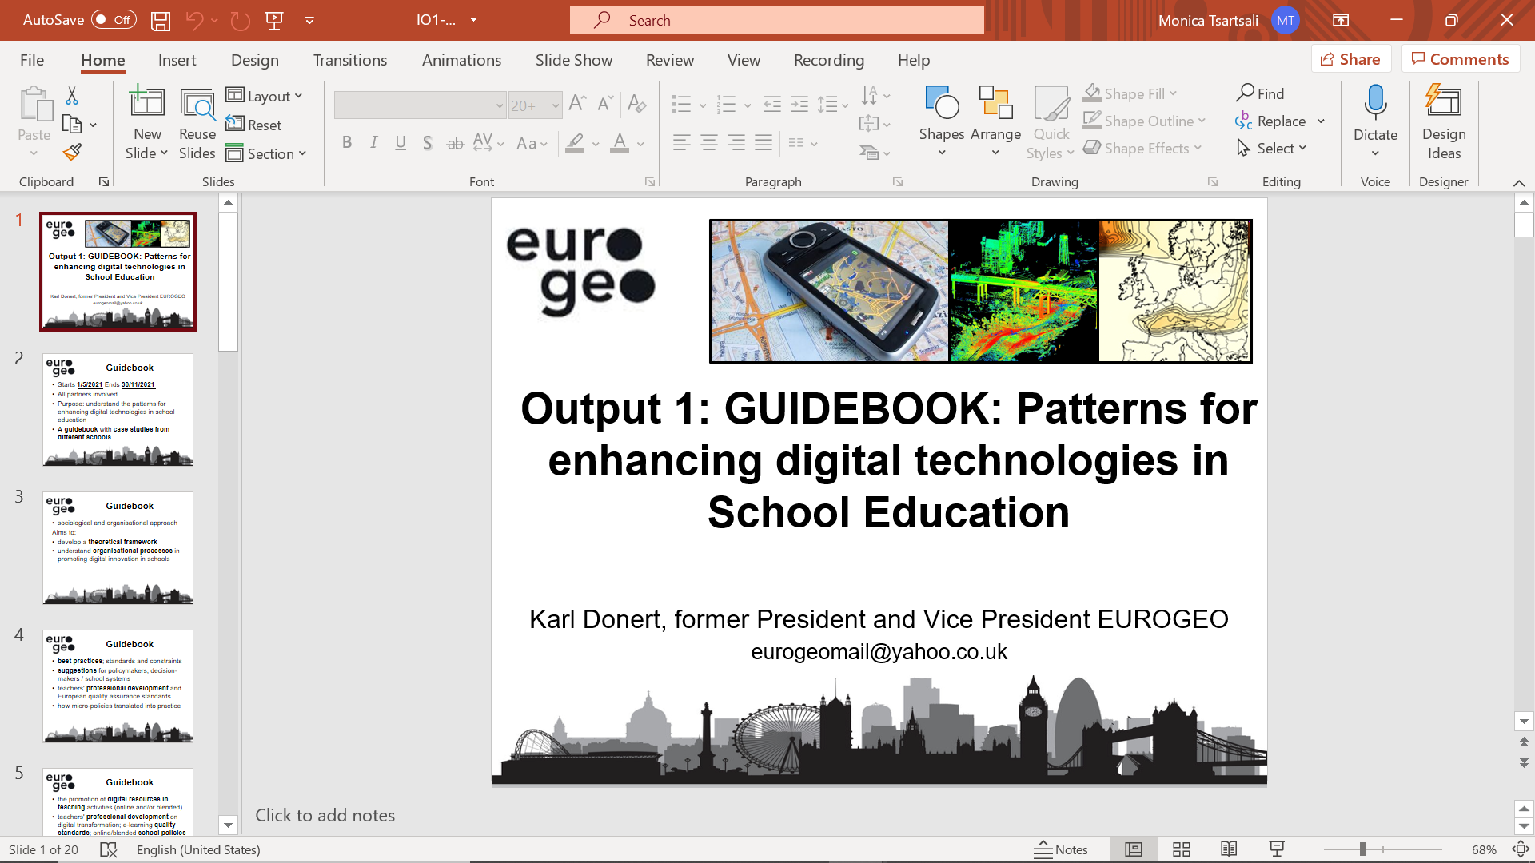







The ONLIFE Partners

