Slide 1


ONLIFE: Empower hybrid Competences for Onlife Adaptable Teaching in School Education in times of pandemic
ONLIFE- Final Event - Brussels
3 May 2023, European Parliament
Reference Number: 2020-1-PL01-KA226-SCH-095529
Title: Guidebook “Pattern for enhancing digital technologies in School Education”
Presenter: Prof. Karl Donert, EUROGEO
This project has been funded with support from the European Commission. This PowerPoint reflects the views only of the author, and the Commission cannot be held responsible for any use which may be made of the information contained herein.

Slide 2

Onlife: lived experience with pervasive technology (Floridi, 2015)

Slide 3
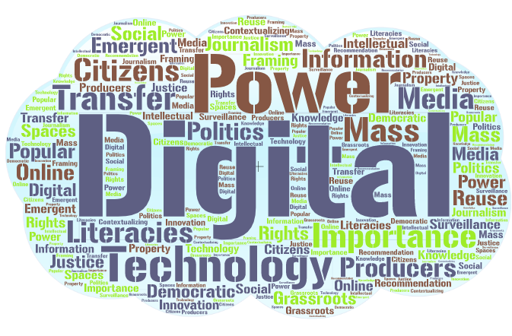
Emerging Digital Spaces (Cope, 2011)
Cope PK (2011), Emerging Digital Spaces in Contemporary Society: Properties of Technology, https://www.researchgate.net/publication/284899164

Slide 4

Guidebook for teachers and educators
Methodology:
Extensive literature review
National case studies
  Desk-based research
  Interviews and
  Focus groups - teachers/managers
Review and analysis
https://shorturl.at/rtLX5

Slide 5
Guidebook for teachers and educators
Research context
ONLIFE
Covid-19 impact
Theoretical framework
SWOC analysis
Case studies
Recommendations
Future perceptions
https://shorturl.at/rtLX5

Slide 6
Guidebook for teachers and educators
“The school lockdown confronted teachers, students, and parents with an entirely new situation”…..
“Continued teaching and learning was only possible through alternative means of schooling.” …..
“Teachers had to change to online teaching, requiring them to use various digital tools and resources” …..
(König et al., 2020)
“learning from home”
(Lorente et al., 2020).
https://shorturl.at/rtLX5

Slide 7

Recommendations

Slide 8
Recommendations strategy and systems
More flexibility to adapt
Preparedness plans for digital approaches
Laws and regulations
(National) Platforms and solutions
Access for all (to online solutions)
Modern training
Re-think broadcasting education
https://shorturl.at/rtLX5

Slide 9
Recommendations teachers and teaching
Increase capacity for virtual teaching
Change school culture
Support for teachers
Student-centred approaches needed
Rethink assessment
Use / generate OERs (Open Education Resources)
https://shorturl.at/rtLX5

Slide 10
Recommendations staff preparation and training
Change of philosophy – facilitate learning
Professional development needed
Revise initial teacher training courses
Ensure online support used
Develop digital pedagogy
https://shorturl.at/rtLX5

Slide 11
Recommendations student learning needs
“Resilience and adaptability will be crucial for next generations.”
“Future employers will highly value creativity, communication, and collaboration, alongside empathy and emotional intelligence.”
…. “train students to …. harness the power of the collective through effective teamwork and global collaboration.”
….” skills essential to navigate the present pandemic—and to prepare for the next one.”
(d’Orville, 2020)
https://shorturl.at/rtLX5

Slide 12
Post-pandemic futures
More resilient systems need technology
Stakeholders (parents, teachers, and authorities) must cooperate
Must prepare for future shocks
Need to develop more flexible curricula
Need exchanges between school and research – for data-driven decision making
“use the momentum to reconfigure learning environments to educate learners for their future, not our past” (OECD, 2021)
https://shorturl.at/rtLX5

Slide 13
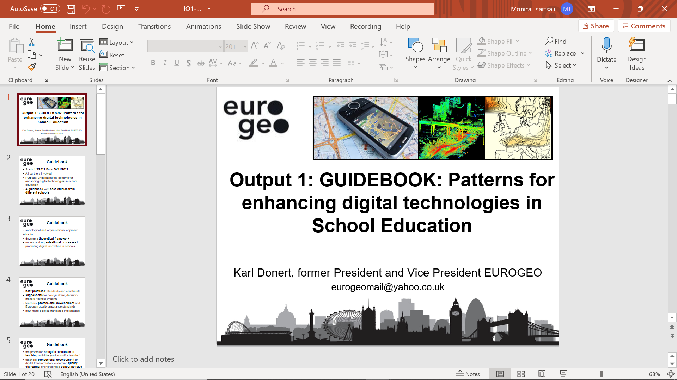







The ONLIFE Partners

