Slide 1


ONLIFE: Empower hybrid Competences for Onlife Adaptable Teaching in School Education in times of pandemic
ONLIFE- Final Event - Brussels
3 May 2023, European Parliament
Reference Number: 2020-1-PL01-KA226-SCH-095529
Title: IO3 - ONLIFE Learning Paradigm (OLP) for the recognition and validation of Competences for School Education (SE) professionals Presenter: Dr. Mario Barajas, University of Barcelona
This project has been funded with support from the European Commission. This PowerPoint reflects the views only of the author, and the Commission cannot be held responsible for any use which may be made of the information contained herein.

Slide 2

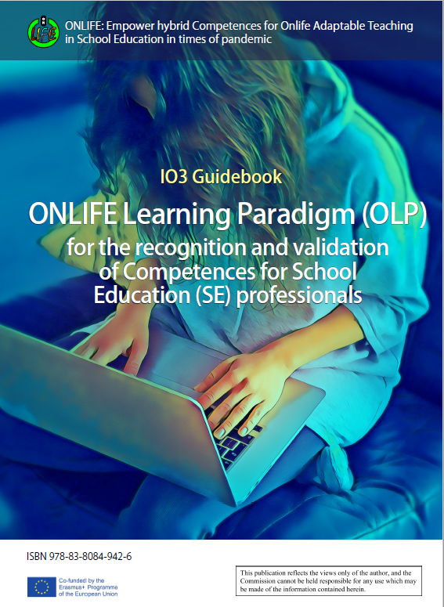
CONTENT
Elaboration of the ONLIFE Learning Paradigm Model
The ONLIFE Framework of competences
Expert evaluation of the framework of competencies
ONLIFE Final framework of competences
Self-evaluation tool for assessing competences
Conclusions

Slide 3
Elaboration of the ONLIFE Learning Paradigm Model
ONLIFE TRAINING MODULES
1. Introducing ONLIFE
2. Online training for learning with online learning environments
3. Digital Skills for online teaching
4. Cooperating, sharing resources and co-teaching
5. Online teaching strategies and relevant practices to enable student learning
6. Effective communication and collaboration using technology
7. Adaptive teachers for disruptive learning scenarios: looking for digital solutions
8. Teachers as Future Multipliers – How To
Categories of competences

Slide 4
The ONLIFE framework of competences
AREAS
LEADERSHIP | Related to establishing a shared vision on how to deal with disruptive situations in educational organisations, being able to negotiate with educational authorities and lead responses.
PEDAGOGY | Related to the use of innovative teaching and learning methodologies adapted to hybrid learning situations (digital/online teaching methodologies).
TECHNOLOGY | Related to the selection of the most appropriate digital learning and communication tools for use in learning environments and institutions.
METACOGNITION | Related to the search for and organisation of one's own learning, individually or in groups, according to one's own emerging needs, and knowledge of innovative methods and opportunities.

Slide 5
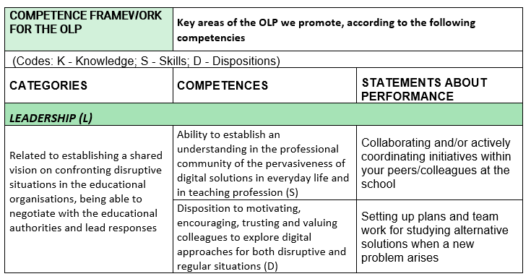
Expert valuation of the framework of competences
Level of competence
A: Changemaker | Leads change by linking stakeholders to plan a response to the situation.
B: Active | Team member who proposes solutions to disruptive educational situations.
C: Adaptive | Adapt plans to their specific situation.
D: Adoptive | Able to apply already developed methods and tools in the classroom.
E: Passive | Knows the problems and tools and waits to be told what to do.
F: Unconscious | Unaware of the problems posed by new situations and the actions to be taken.

Slide 6
Expert evaluation of the competence framework
Focus groups with a total of 55 experts in the participating countries (6)
Exchange and discussion about the following questions:
Do you find these specific competencies important and relevant?
Do you feel that some of the competencies overlap, and they could be better expressed as one?
Can you think of other, useful competencies for measuring readiness to adapt in pandemic situations?
On a scale of 1-10 rate the sufficiency of these competencies.
Propose policy recommendations at national level
- Synthesis of results with proposed recommendations:
Pedagogy and Technology were rated higher (9 overall)
Leadership and Metacognition were rated 8 overall

Slide 7
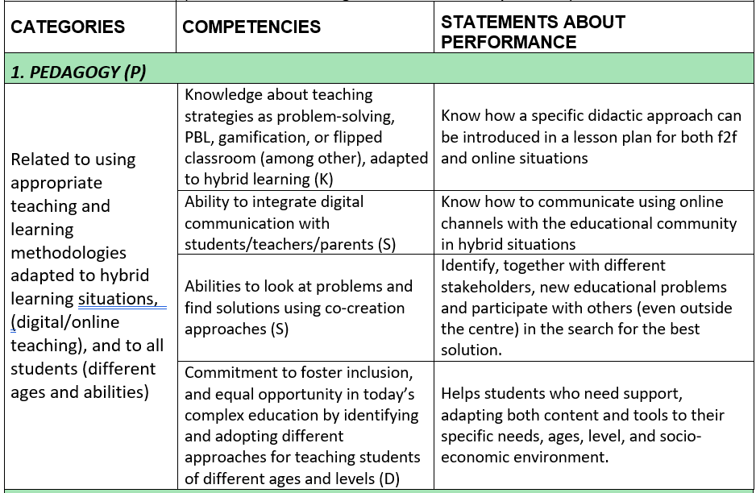
ONLIFE Competence framework

Slide 8
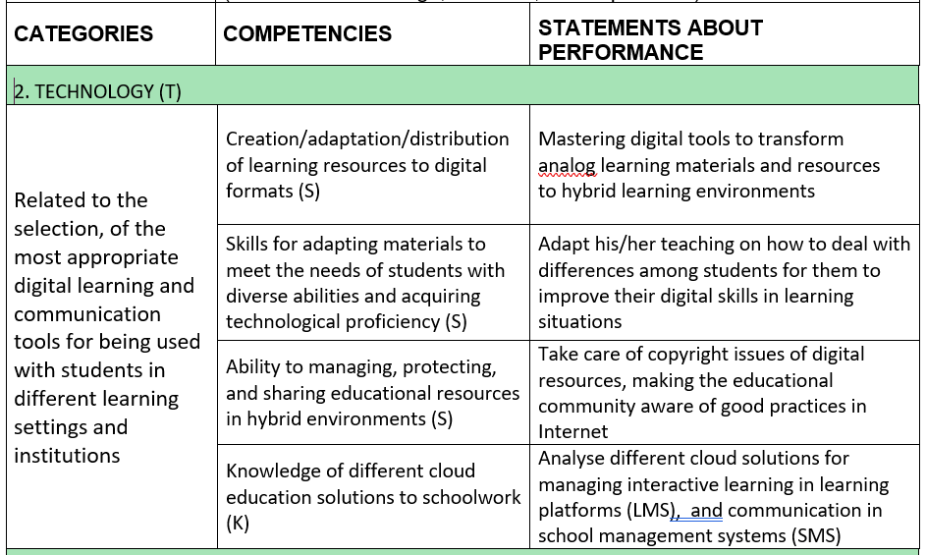
ONLIFE Competence framework

Slide 9
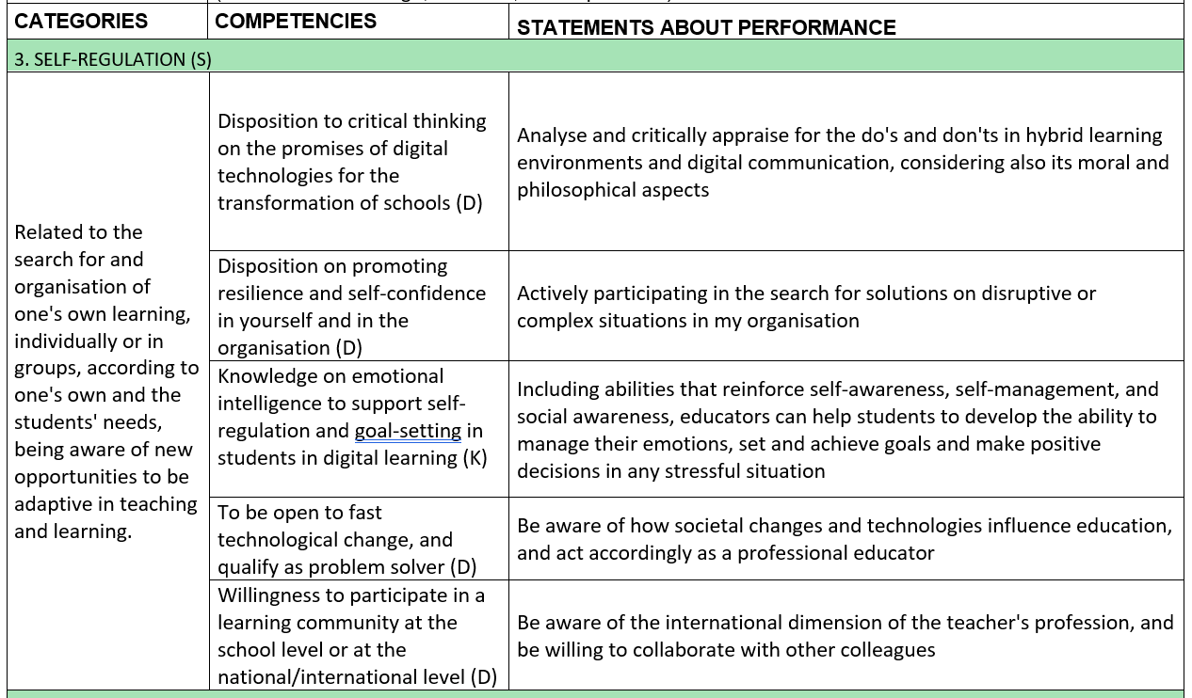
ONLIFE Competence framework

Slide 10
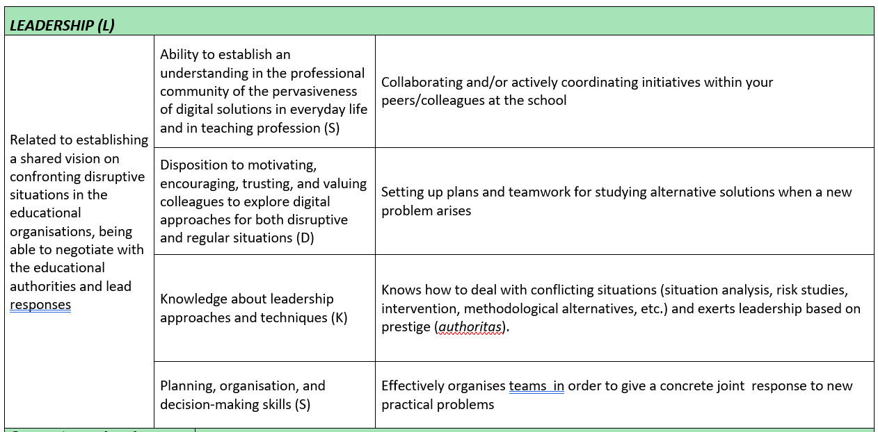
ONLIFE Competence framework

Slide 11
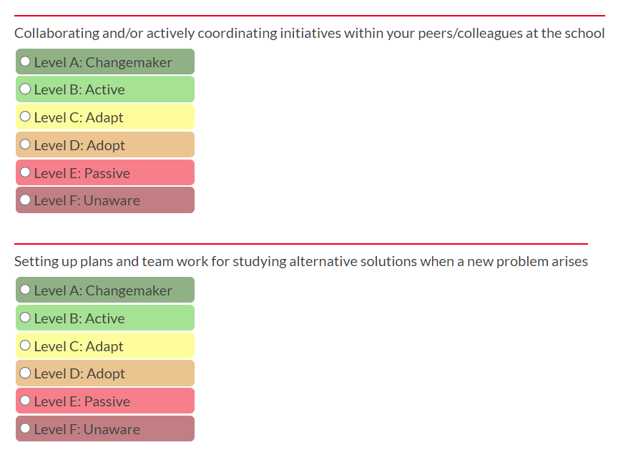

Self-evaluation tool for assessing competencies
A self-assessment tool based on the ONLIFE Learning Paradigm, at https://onlife.up.krakow.pl/test/, will help the broadly understood school community stakeholders to diagnose their hybrid competencies for ONLIFE Adaptable Teaching in School Education.
The user is prompted to self assess own competence level on the scale from A (changemaker) to F (unaware). Based on results of this anonymous process, the tool fully automatically provides recommendations for taking certain modules of the main course.

Slide 12
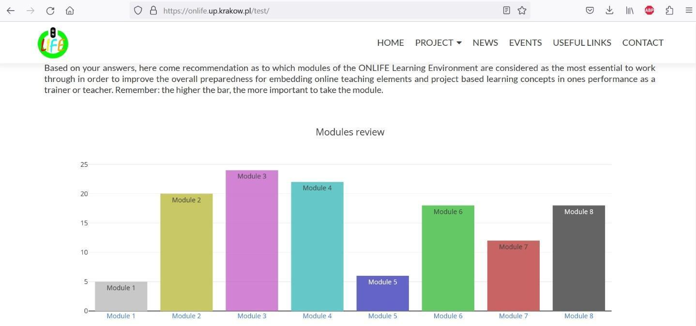
Self-evaluation tool for assessing competencies
Module 3 of the course is recommended as the most necessary module to complete in order to improve one's competences. By simply placing the cursor on the bar representing this module and clicking on it, the user is automatically taken to the relevant part of the course (first-time visitors will have to go through a simple and easy registration process).

Slide 13
Conclusions
The competence framework supporting the ONLIFE Learning Paradigm (OLP) has been well received by both specialists and professionals. The suggestions have been included in the model, as they all fit well into the model.
The competence model includes four main areas: pedagogy, technology, self-regulation and leadership, with a total of seventeen competencies (four are knowledge, seven are skills and six are dispositions).
The OLP competence model is a step beyond the DigiCompEdu, SELFIE and L-CLOUD competence models, and can be considered a natural evolution of them, introducing those competencies that were identified during the pandemics.
We believe that the ONLIFE model is a starting point for cloud education in Europe
The model can help teachers, principals, and school institutions as a whole to make a diagnosis in order to be prepared for any disruptive or complex situation that may occur in the future of educational systems.
The model can be used to update the contents and methods of teacher training programs, whether initial or continuing education

Slide 14








The ONLIFE Partners

